Slide 1
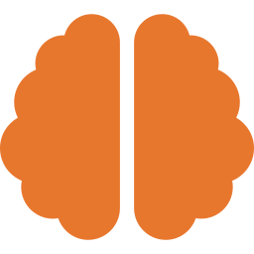
The Human Brain
Eighty-six billion neurons and the mystery of consciousness

Slide 2
By the numbers
86 billion
~100 trillion
3 lb
20%
neurons
connections (synapses)
about 2% of body weight
of the body's energy
Neurons signal with tiny electrical pulses and chemical messengers.
The Big Questions · 6 of 25
2

Slide 3
Who does what
Part | Main job
Frontal lobe | Planning, decisions, personality
Hippocampus | Forming new memories
Cerebellum | Balance and coordination
Brainstem | Breathing and heartbeat
Occipital lobe | Vision
Most tasks use many regions working together.
The Big Questions · 6 of 25
3

Slide 4
What we know and don't
Known
Still a mystery
The brain rewires itself as you learn
Sleep helps lock in memories
Exercise and learning help keep it healthy
How brain activity becomes conscious experience
Exactly how memories are stored
Why we dream
Sources: National Institutes of Health; Society for Neuroscience
The Big Questions · 6 of 25
4

Slide 5
Remember
The brain keeps changing all your life; how its activity becomes your experience is still unsolved.

