Slide 1
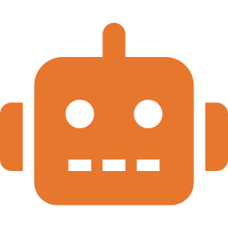
Robotics and Automation
Machines that sense, decide and act

Slide 2
How a robot works
1
Sense
Cameras, touch and position sensors
A control loop
The same sense–decide–act loop engineers use in reactors and autopilots.
2
Decide
A computer compares what it senses to its goal
3
Act
Motors move arms, wheels or grippers
4
Check and repeat
Feedback corrects every motion
The Big Questions · 19 of 25
2

Slide 3
Robots at work
Year | Milestone
1961 | Unimate, the first industrial robot, joins a GM factory
2000 | da Vinci surgical robot cleared in the U.S.
2004–today | Rovers explore Mars
Today | Over 4 million industrial robots work worldwide
Warehouses, farms and hospitals are adding robots fastest.
The Big Questions · 19 of 25
3

Slide 4
Promise and questions
Promise
Questions
Safer work in dangerous places
Steadier, more precise surgery
Help for elderly and disabled people
Jobs that change or disappear
Safety around people
Cost and repairs
Sources: International Federation of Robotics; NASA; Smithsonian
The Big Questions · 19 of 25
4

Slide 5
Remember
Robots sense, decide and act in a loop; adding AI makes that loop far more flexible.

