Slide 1
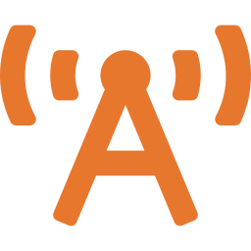
Ham: Keeping a Family Talking
One test, a $35 license and a radio that reaches repeaters, nets and help miles away

Slide 2
The license at a glance
$35
35
26
10
one-time FCC fee
questions on the test
right answers to pass
years before renewal
No Morse code since 2007. Exam groups charge a small session fee, often $15 or less, and some are free.
Do Interesting Things · 2 of 17
2

Slide 3
Get licensed in four steps
1
Get an FCC Registration Number
Free, on the FCC CORES website
One license per person
Unlike GMRS, every family member who talks on ham radio needs their own license. There's no age limit, and ARRL exam teams charge kids under 18 just $5 and repay their $35 FCC fee.
2
Study the Technician question pool
Every question is public; practice free at PassThePool.com
3
Take the test at a local exam session
Find one on ARRL.org; bring photo ID and your FRN
4
Pay $35 and get your call sign
The FCC emails a payment link; your call sign follows within days
Do Interesting Things · 2 of 17
3

Slide 4




Using the radio
Say your call sign
Every 10 minutes and at the end of a conversation
Use a repeater
Set the offset and tone; a hilltop repeater carries you 20 miles or more
Join a weekly net
Check in to practice before you ever need it
Plain language only
No codes, no encryption, no business talk
Do Interesting Things · 2 of 17
4

Slide 5
How far it reaches
Setup | Typical range
Handheld to handheld, in town | 1 to 3 miles
Handheld from a hilltop | 5 to 20 miles
Mobile radio with roof antenna | 10 to 30 miles
Through a repeater | 20 to 60 miles
HF radio (General license) | Hundreds to thousands of miles
Typical estimates for 2-meter and 70-centimeter radios. Hills, trees and antennas change everything, so test from your own home.
Do Interesting Things · 2 of 17
5

Slide 6
Remember
GMRS keeps the family talking; ham radio connects you to the whole region when the phones go down.

